Slide 1
Team 9 IDR 2
Aerobatics Black Box

Slide 2
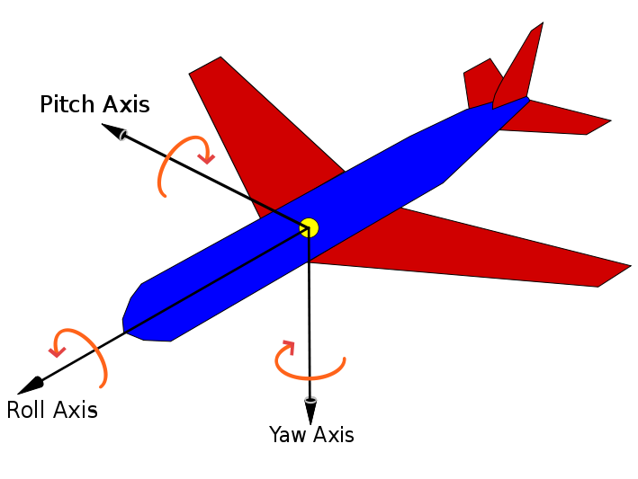
Goals
Record the telemetry (position and orientation, airspeed) of an aerobatic flight
Record the pilot’s inputs while flying (rudder pedals, flight stick)
After the flight, display a visualization of the flight and the pilot’s corresponding inputs that can be viewed from any angle

Slide 3
Functions and Means: Telemetry
Attitude (3D orientation) – Pitch, Roll, and Yaw
Purchased 9 DOF IMU with Pressure Sensor
Position – Latitude, Longitude, Altitude
Purchased GPS module
Data storage, processing, and transfer
Use a Raspberry Pi to read data from the sensors, store the data in its SD card, and write it to some easily removable media like a USB stick
Use an algorithm to convert raw sensor readings to attitude and position

Slide 4
Functions and Means: Pilot’s inputs & Airspeed
Rudder Pedals and Flight Stick
The rudder pedals and flight stick are connected to the flight surfaces (rudder, elevators & ailerons) by cables running through the body of the plane.
Approach: Place colored tape on each cable and track its movement using a camera and some light visual processing.
Airspeed Indicator (located in the dashboard)
Approach: Place a camera in the cockpit looking at the airspeed indicator, and do some light visual processing to read it.

Slide 5
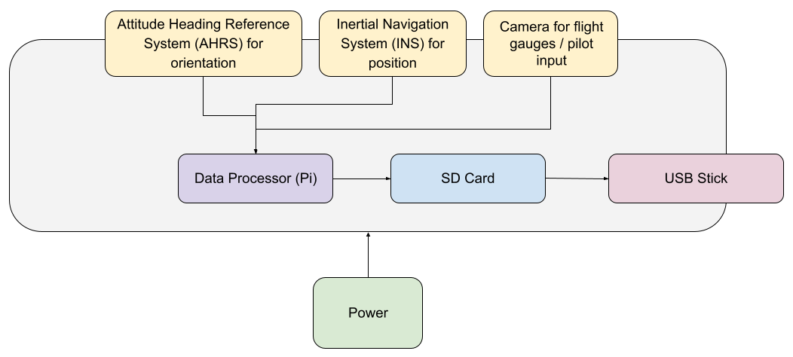
Hardware Diagram

Slide 6
Functions and Means: Visualization
Flight Data Storage
Write raw and processed sensor data to Pi’s SD card as it is generated
Periodically write raw and processed sensor data to a removable USB stick
Visualization
Generate a .fdr (Flight Data Recorder) from the recorded data on the Pi
Transfer the file to a laptop using a USB stick
Load the file into X-Plane (flight simulator), which will visualize it
* Users would have to buy the simulator

Slide 7
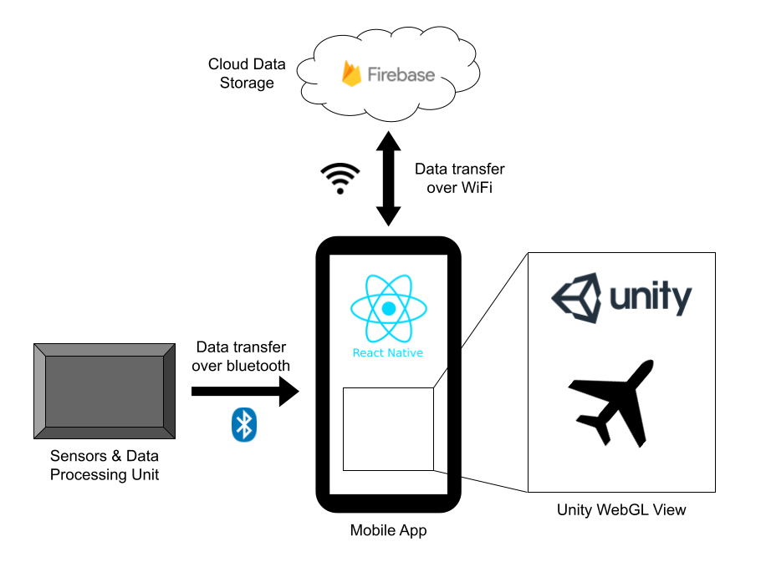
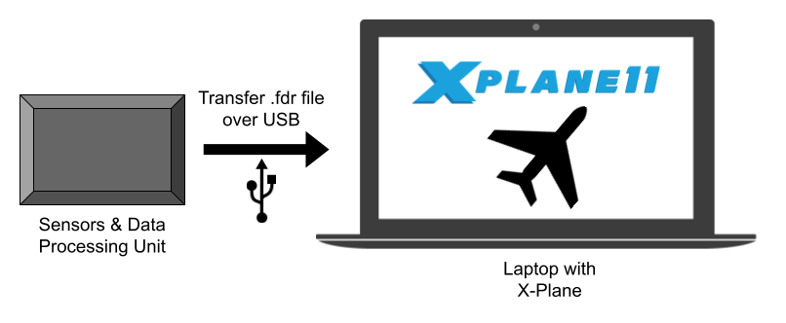
Software Diagram

Slide 8
X-Plane vs. Custom Mobile App
X-Plane
Much less work
More detailed visualization
.fdr files are future-proof
Manually transfer data on USB
Users must buy X-Plane to use our project
Custom Mobile App
Much more work
Automatically handle data transfer and storage
Less detailed visualization
(Possibly) More control over the visualization

